Slide 1

Customer Churn Analysis using Power BI
Name : Mahesh Dugyani
Batch - 422
Data Science Student / Innomatics Research Lab

Slide 2
Customer Churn Analysis
Leveraging Power BI for Data-Driven Retention Strategies
Presented by: Mahesh Dugyani
Data Science Student | Innomatics Research Lab
Date: October 17, 2025
LinkedIN : https://www.linkedin.com/in/maheshdugyani/
Github: https://github.com/mahesh-dugyani

Slide 3
Problem Statement
1️⃣ High Customer Churn Rate: The telecom company is facing a high customer churn rate of around 26%, which leads to significant revenue loss and increased acquisition costs.
2️⃣ Lack of Customer Retention Insights: The business lacks a clear understanding of why customers are leaving, making it difficult to take data-driven actions to improve customer loyalty.
3️⃣ No Systematic Monitoring of Churn Drivers: There is no automated dashboard or predictive model in place to identify high-risk customer segments or monitor churn patterns regularly.
4️⃣ Service and Contract Challenges: Customers with month-to-month contracts and fiber optic internet plans show higher churn, but the company lacks visibility into these patterns and how they connect to other
*The telecom company needs to identify key factors influencing churn and implement data
driven retention strategies to reduce customer loss
.

Slide 4
Data Overview
The dataset used in this project is titled “Customer-Churn-analysis”, which contains detailed
information about customers of a telecom company — including their demographics, service
subscriptions, billing patterns, and churn status.
It helps analyze customer behavior and uncover patterns that contribute to customer churn.
Feature Type | Description
Number of Records | 7,043 customers
Number of Columns | 21 attributes
Target Variable | Churn (Yes/No)

Slide 5
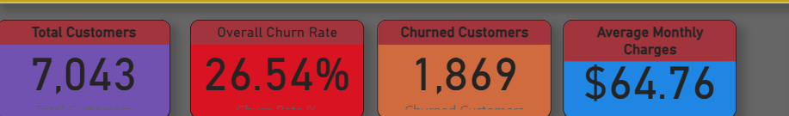
Business Impact Overview
• Customer Base: 7,043 total customers with 27% churn rate
• Financial Impact: $64.76 avg monthly revenue, $2.28K lifetime value
• Key Finding: Contract type predicts churn - 14x difference
• Opportunity: Target high-value short-term customers

Slide 6
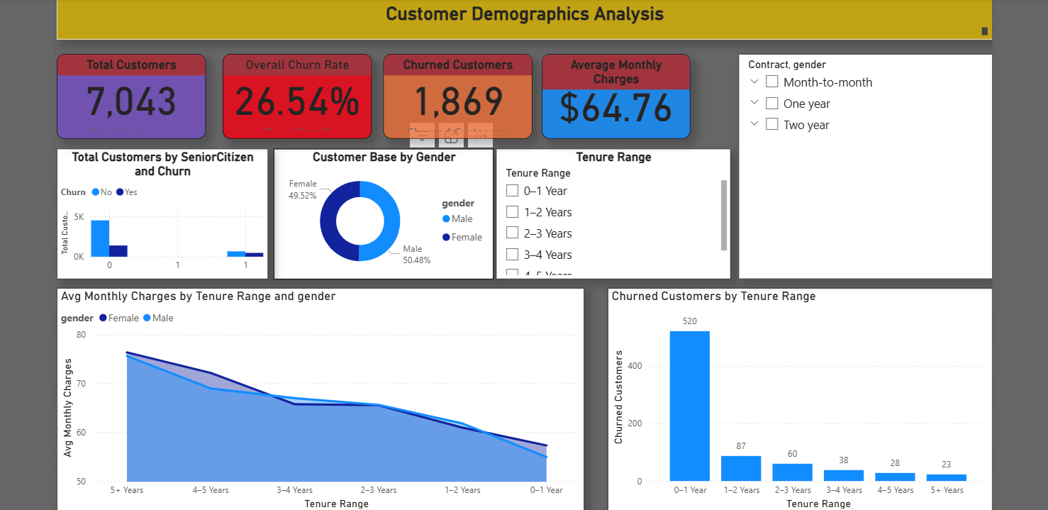
Customer Demographics Analysis

Slide 7
Understanding Our Customer Base
• Balanced Demographics: 49.5% male, 50.5% female
• Service Adoption: 90% have phone service
• Senior Citizens: Different retention patterns
• Family Focus: Dependents affect retention rates

Slide 8
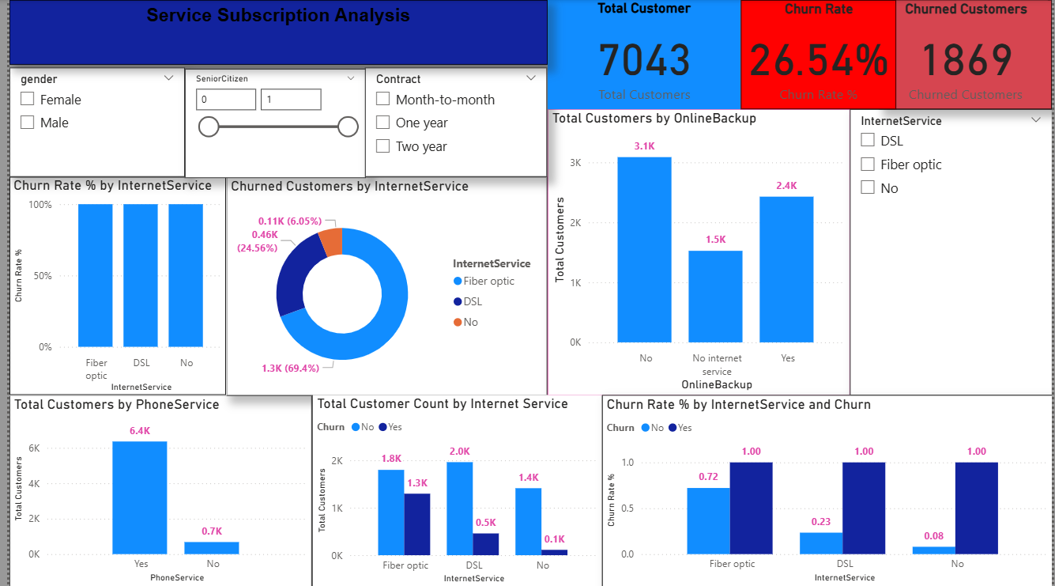
Service Subscription Analysis

Slide 9
Service-Specific Retention Patterns
• Fiber Optic Crisis: 68% of churned customers on fiber
• Bundle Success: More services = lower churn
• Upsell Opportunity: Only ~1,000 have security add-ons
• Basic Loyalty: No internet customers most loyal

Slide 10
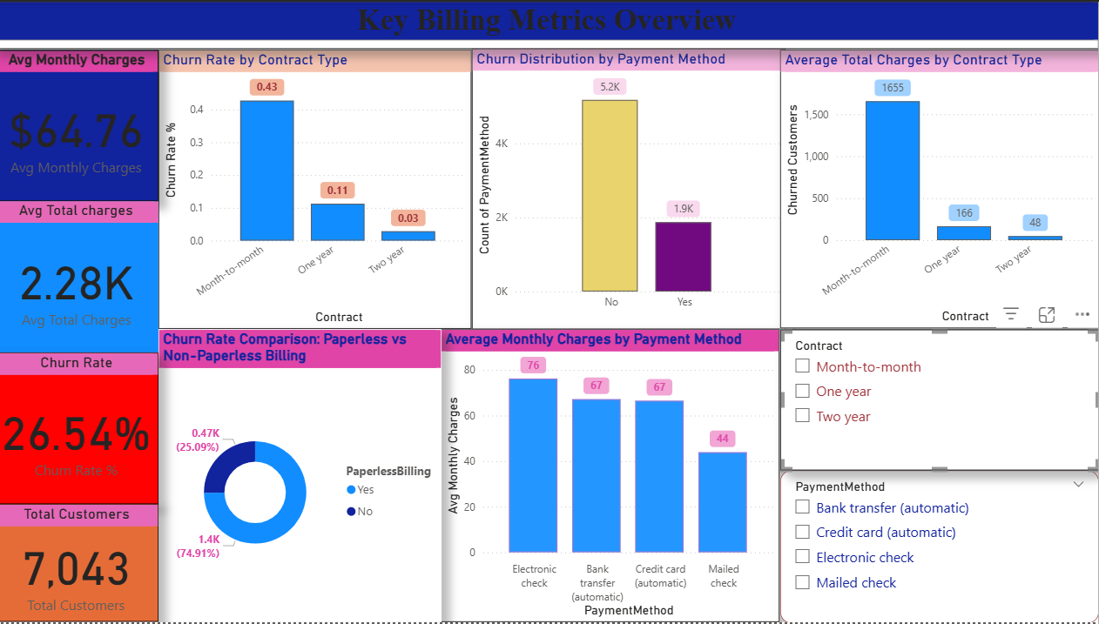
Key Billing Metrics Overview

Slide 11
Contract Type - Primary Churn Predictor
• Dramatic Difference: 43% vs 3% churn (14x difference!)
• Payment Patterns: Electronic check users highest risk
• Digital Paradox: Paperless billing = higher churn
• Value Loss: Month-to-month customers churning fast

Slide 12
Data-Driven Action Plan
1️⃣ Strengthen Long-Term Contracts
Encourage customers to switch from month-to-month to annual or two-year contracts
through:
Loyalty rewards and discounts.
Early renewal benefits.
Expected Impact → Reduce churn by ~10–15%.
2️⃣ Improve Customer Experience for Fiber Optic Users
Conduct targeted feedback surveys for fiber users.
Improve speed reliability and pricing transparency.
Offer service upgrades for loyal customers.
Expected Impact → Reduce dissatisfaction-driven churn.

Slide 13
Conclusion
The overall churn rate among customers is approximately 26%, indicating a significant portion of customers leaving the service.
Contract type is one of the strongest churn drivers — Month-to-month customers show
the highest churn, while Two-year contract customers have the lowest churn rate.
Fiber optic users experience higher churn compared to DSL users, suggesting potential dissatisfaction with service quality or pricing.
Customers without Online Security or Tech Support are more likely to churn, showing that value-added services play a key role in retention.
Short-tenure customers (less than 1 year) tend to leave more often, implying the need for early engagement and retention offers.
Payment method also affects churn — customers using Electronic Check have a higher likelihood of churn than those using automatic payment methods.

Slide 14

THANK YOU

